Slide 1
Banner Wireless
Jade Preisen
Senior Applications Engineer

Slide 2
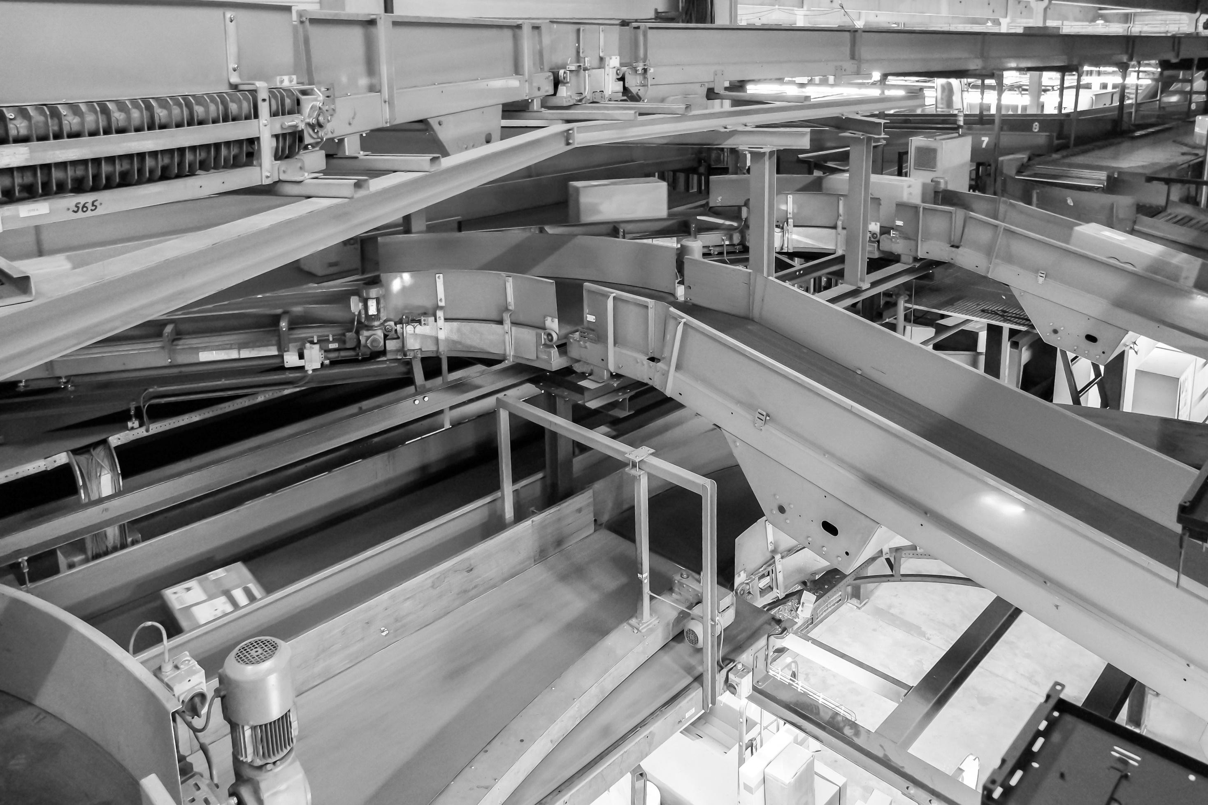
Frequencies

Slide 3
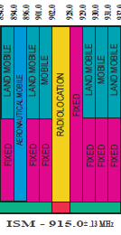
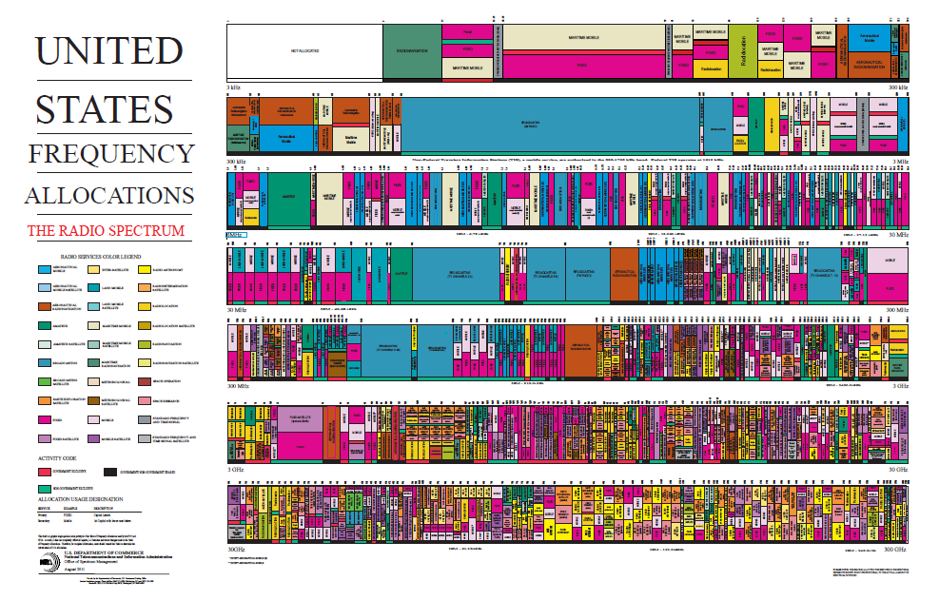
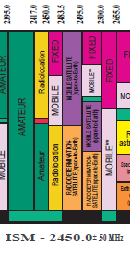
Frequencies

Slide 4
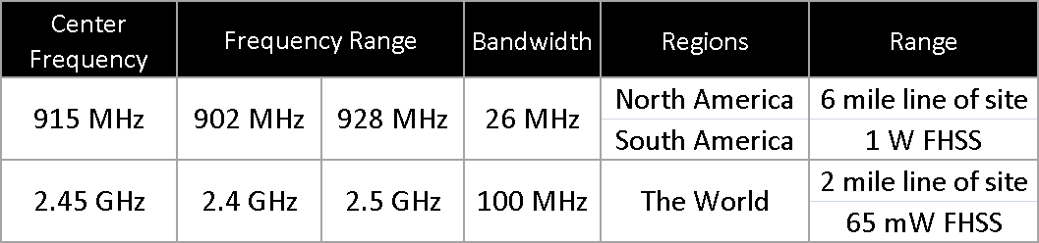

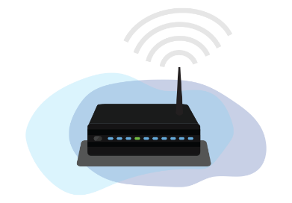
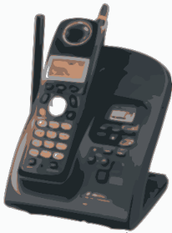
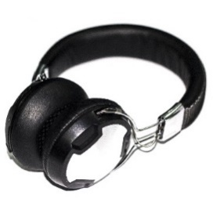

Frequencies: Industrial Science Medical “ISM”
900 MHz
Cordless phones
Walkie Talkies
Amateur TV
FM Repeaters
2.4 GHz
Wifi
Bluetooth – Video Games
ZigBee Radios
Wireless Hart Radios

Slide 5
Networks

Slide 6

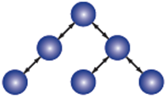
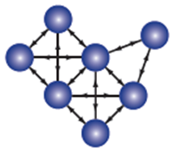
Network Types
Star Topology
Multi-hop Topology
Mesh Topology
One central control radio
All information must pass through the central radio
Controlled path with defined master, repeaters and slaves
Master radio controls timing and routing within network
Adding additional radios does not slow entire network
Normally have a defined radio limit
Multiple connections per radio
Master Radio can be positioned anywhere in the mesh
Less efficient, shorter range, typically shorter speeds
Addition of new nodes slows entire network

Slide 7
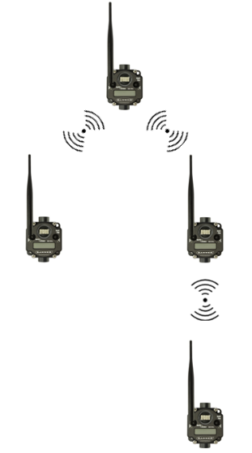
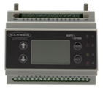
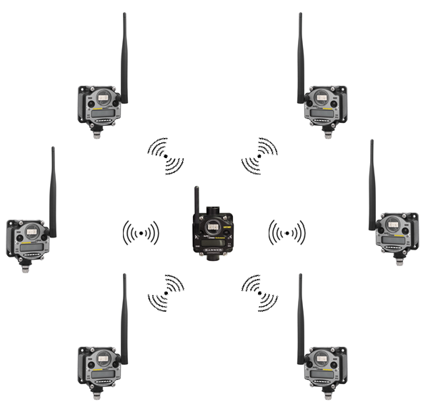
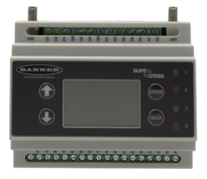
Network Types: Banner Radios
DX80
Star Network
(up to 47 nodes)
Multi-hop
Tree Network
(up to 50 total)
Gateways & Nodes
Master, Slaves, & Repeaters
Notes:
DX80 Networks
Point to Point or Star Topology
Gateways communicate to Nodes and any connected Host System (PLC)
Less complicated - Nodes talk only to Gateway
Gateway can be used as repeater
Multi-Hop Netwoks
Tree Topology
Master communicates to slaves
Able to use repeaters

Slide 8
Network Types: Banner – Star vs. Multi-hop
Star Topology
Multi-hop Topology
Point to Point, Point to Multipoint, One Hop
Stand alone network or Host Controlled
Pre-defined outputs on Link Loss
DX80/Performance/Gateway-Node
Frequency Hopping Spread Spectrum
Timer Division Multiple Access
Point to Point, Multiple hops via repeaters
Host Controlled ONLY (Requires Modbus Master)
Self Healing Network
Multi-hop/Master-Slave/Data Radio
Frequency Hopping Spread Spectrum

Slide 9
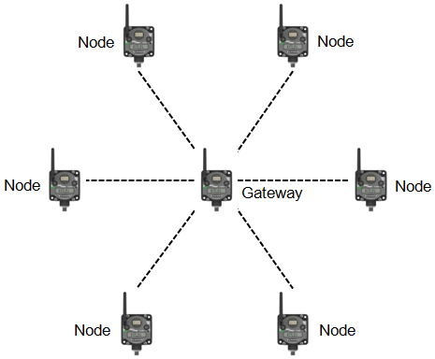
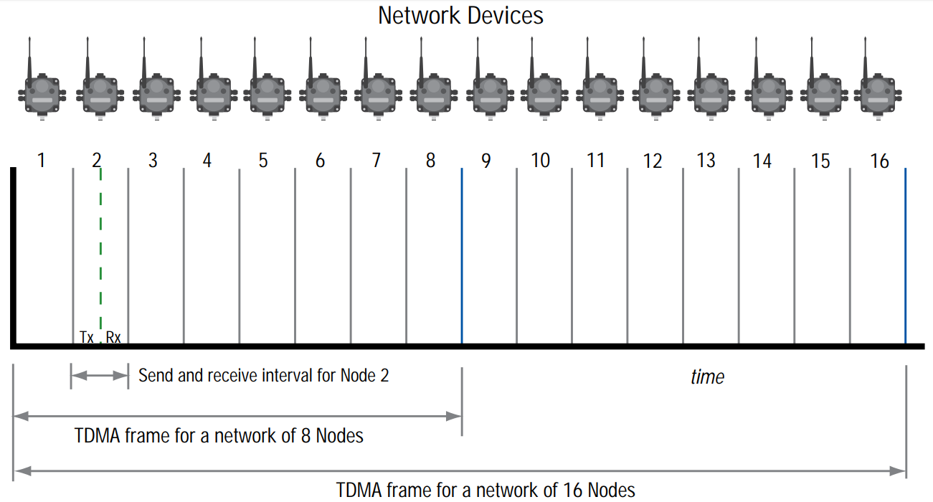
Network Communication: TDMA
TDMA – Time Division Multiple Access
Gateway communicates with each individual node during a designated time slice
Eliminates data collisions between radios on network
Each Radio gets a chance to transmit and receive
8 Nodes per network - 0.0625 sec update cycle
16 Nodes per network - 0.125 sec update cycle
32 Nodes per network - 0.250 sec update cycle
47 Nodes per network - 0.500 sec update cycle

Slide 10
Network Communication: FHSS vs DSSS
DSSS
Lower average power level
Higher possible data rates
DSSS = Direct Sequence Spread Spectrum
Spread Signal
Network ID
902 MHz
928 MHz
FHSS = Frequency Hopping Spread Spectrum
FHSS
Higher average power level
Transmits further
Higher noise immunity
1
2
3
. . . . . . . . . . . . . . . . . . . .
25
26
27
902 MHz
928 MHz
Notes:
DSSS: The DSSS encoder spreads the data across a broad range of frequencies using a mathematical key. The receiver uses the same key to decode the data. Although narrowband and DSSS transmissions use the same total power to send data, DSSS uses a lower power density (power/frequency), making it harder to detect. DSSS also sends redundant copies of the encoded data to ensure reception. Narrowband interference appears to the receiver as another narrowband transmission. When the total received signal is decoded, the wider band transmission (DSSS encoded data) is decoded back to its original narrowband format while the interference is decoded to a lower power density signal, thereby reducing its effects
FHSS: When using FHSS, the frequency spectrum is divided into channels. Data packets are split up and transmitted on these channels in a random pattern known only to the transmitter and receiver. Because collocated networks follow different random patterns͕ or hop code tables, multiple networks can operate in proximity without interfering. If interference is present on one channel, data transmission is blocked. The transmitter and receiver ‘hop’ to the next channel in the hop table and the transmitter resends the data packet. Frequency hopping technology works best for small data packets in high interference environments. Generally, FHSS can resist interference from spurious RF signals ten times better than DSSS.

Slide 11
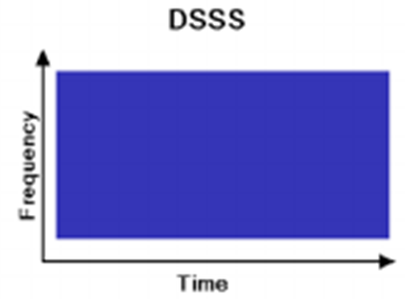
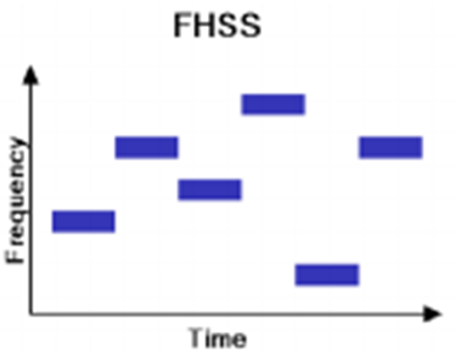
Network Communication: FHSS vs DSSS
DSSS = Direct Sequence Spread Spectrum
DSSS
Lower average power level
Higher possible data rates
FHSS = Frequency Hopping Spread Spectrum
FHSS
Higher average power level
Transmits further
Higher noise immunity

Slide 12
FHSS
FHSS = Frequency Hopping Spread Spectrum
Change transmission frequency every 20ms
100 mW
HOP TABLE
2,4 GHz
2,5 GHz
1
1,7,13,5,20…
All transmitters and receivers hop onto a different carrier frequency according to a predetermined, pseudo-random sequence (or “hop table”) in order to increase possibility of data getting through.
2
20,13,5,7,1…
3
7,13,1,20,5…
4
1
2
3
. . . . . . . . . . . . . . . . . . . .
5
25
26
27
100 mW
2,4 GHz
2,5 GHz

Slide 13
Network Communication: Multi-hop
Master Slave Network
  Master Radio establishes timing and controls communications
  Slave Radios may not initiate any communications to the master radio
  Slave Radios may not communicate with other slaves
Requires Modbus Master
  Communications between slaves are initiated by the Modbus Master (PLC, Host System, DXM)
  Master radio routes requests to wireless and wired slave devices
Notes:
***push registers are exception

Slide 14
Security

Slide 15
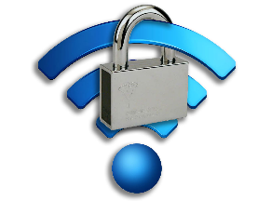
Banner Wireless Security
Frequency hopping (FHSS) & TDMA
Network Isolation
Proprietary Protocol
Inability to route malicious TCP/IP packets
Notes:
Frequency hopping
Frequency hopping between 27 different frequencies within a small band and random pattern
Network Isolation
Isolated from other wireless networks in the area
Proprietary Protocol
Difficult to interpret/decipher the information received
Low Value Target
In rare case where data may be intercepted and viewed, the data is only generic sensor data with no context provided.
Inability to route malicious TCP/IP packets
Only transmitting I/O and not executables or webpages.
Tech Note available at BannerEngineering.com (see link above)
No login, no port access, no method of access through the wireless network
No operating system and no facilities to gain access to other connected devices
There is no way for a malicious file to enter your ethernet network through a Banner Sure Cross wireless system

Slide 16
Banner Wireless Security: Banner Wireless in a Wifi Environment
Will Banner’s wireless systems work with your existing 802.11 (Wi-Fi) network? Yes, it will work exceptionally well!
All 2.4GHz products require FCC certification
  Inherently “play nice together”
  Limits transmission power, duration, and communications methods used
2.4GHz radios expect a noisy environment
  Some devices are bandwidth “hogs” and others consume close to nothing
Notes:
Networks use multiple frequency channels, coding algorithms, timing, and signal transformation algorithms to provide reliable wireless connections even in noisy environments.
Based on military developments that resist jamming and interception.
All products used in the 2.4 GHz band need to be certified. So on a basic level, all 2.4 GHz devices are designed to work together and reliably communicate in the presence of other devices.
A radio can only interfere when it’s transmitting
The low data rates and narrow frequency band of the Banner wireless make it almost silent to the 802.11b

Slide 17
Banner Wireless Security: Banner Wireless in a Wifi Environment
Minimizing Interference
Minimize the Bandwidth that we consume
  Minimize the time that our radios are transmitting
  Minimize the power that is transmitted
Wifi (802.11)
  Power: 100mW
  Communication: DSSS
  Frequency: 2.4 – 2.483 GHz (22MHz Spacing)
  Channels: 13
Banner Wireless
  Power: 65mW
  Communication: FHSS
  Frequency: 2.423 – 2.478 GHz (2MHz Spacing)
  Channels: 27

Slide 18
Antenna

Slide 19
Antenna basics
An antenna is a device that is made to efficiently radiate and receive radiated electromagnetic waves
An antenna is an electrical conductor or system of conductors.
  Transmission radiates electromagnetic energy into space
  Reception collects electromagnetic energy from space.
In two-way communication, the same antenna can be used for transmission and reception.

Slide 20
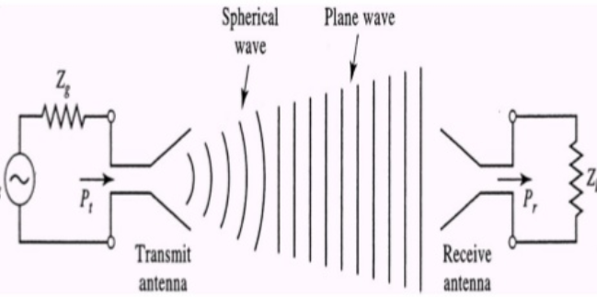
Antenna basics: Transmit and receive antennas
Electrical energy from the transmitter is converted into electromagnetic energy by the antenna and radiated into space
On the receiving end, electromagnetic energy is converted into electrical energy by the antenna and fed into the receiver

Slide 21
Antenna basics: Gain
Antenna Gain can be characterized using dBi
  Antenna gain can be measured in decibels against a computer modeled antenna called an “isotropic” dipole <ideal antenna> and the unit of measure is dBi (i for isotropic dipole) (computer modeled ideal antenna)
  Can also reflect the antennas electrical efficiency
Notes:
WiFi antennas are typically rated in dBi.
dBi is a HIGHER value (marketing folks like higher numbers)
Conventional radio (Public safety) tend to use a dBd rating.
To convert dBd to dBi, add 2.14 so a 3 dBd = 5.14 dBi

Slide 22
Antenna Gain
Antennas are usually designed to operate at a specific frequency
Antenna Gain is characterized using dBd or dBi
  Antenna gain can be measured in decibels against a reference antenna called a dipole and the unit of measure is dBd (d for dipole)
  Antenna gain can be measured in decibels against a computer modeled antenna called an “isotropic” dipole <ideal antenna> and the unit of measure is dBi (i for isotropic dipole) (computer modeled ideal antenna)
WiFi antennas are typically rated in dBi.
  dBi is a HIGHER value (marketing folks like higher numbers)
  Conventional radio (Public safety) tend to use a dBd rating.
  To convert dBd to dBi simply add 2.14 so a 3 dBd = 5.14 dBi
  Again… dBd is decibel dipole, dBi is decibel isotropic

Slide 23
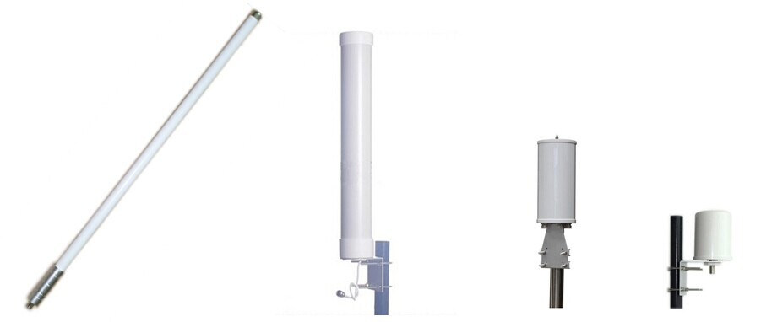

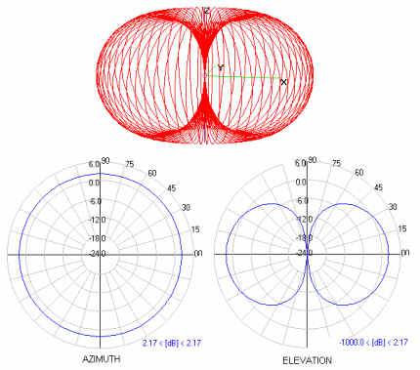
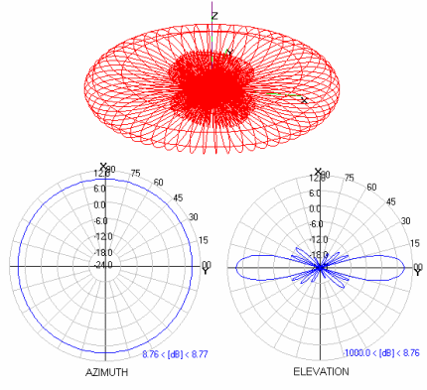
Antenna basics: Gain
How does an Omni directional antenna radiate?
Compare it to a Donut
2 dB is circular
+/- 800m range with DX80
7 dB is flatter but covers a larger distance

Slide 24
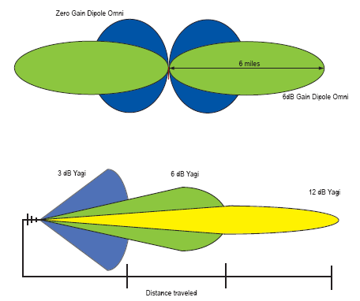
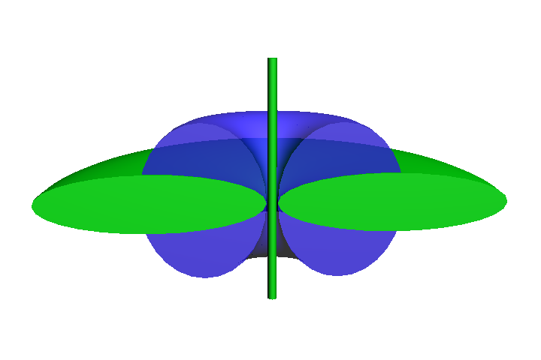
Antenna basics: Gain
Relates directly to an antenna’s radiation pattern and range
Adding gain does not amplify the signal; it focuses it, the same amount of power through the antenna – this is dictated by the frequency and power of the RF amplifier
In USA, Federal Communication Commission (FCC) states that radio system may not exceed 30 dBm EIRP
EIRP = Emitted Isotropic Radiated Power

Slide 25
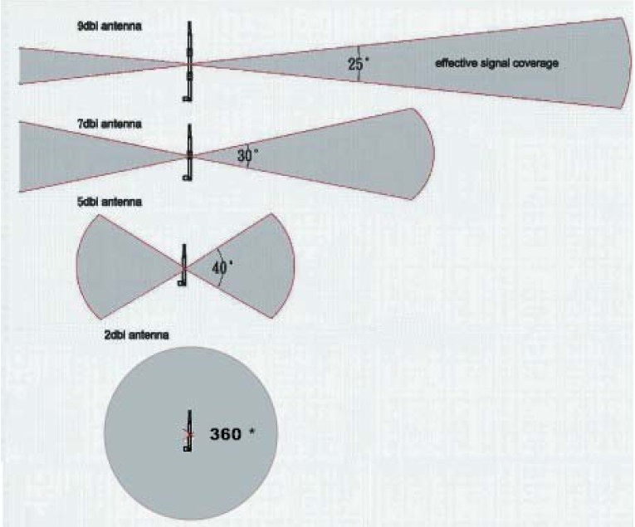
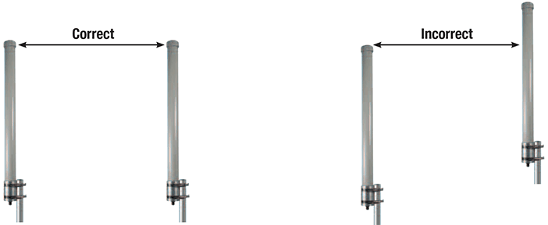
Antenna basics: Omni directional antennas
Higher dB antennas have
longer range
Donuts must overlap
High dB antennas are more difficult
to align due to narrower beam pattern

Slide 26
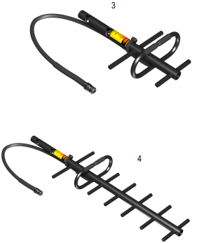
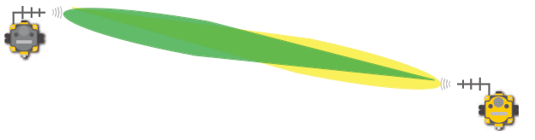
Antenna basics: Directional antennas
High Gain antennas used for long distance communication
Beam patterns look more like cones
Very difficult to align
  Antenna mounting height is key
  Small changes in direction (angle) can largely effect signal strength

Slide 27
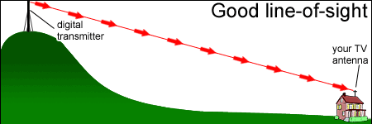
Antenna basics: Line of Sight (LoS)
Line of sight is important for the quality of the radio communication
The antennas must see each other

Slide 28
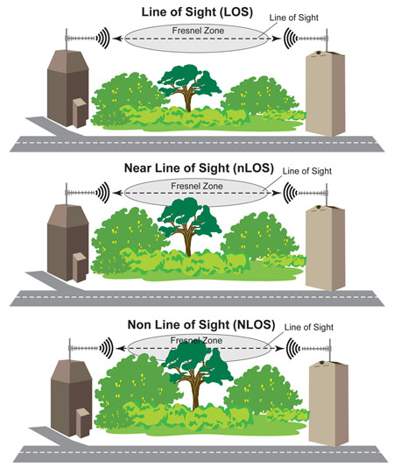
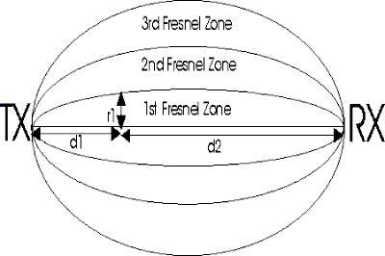
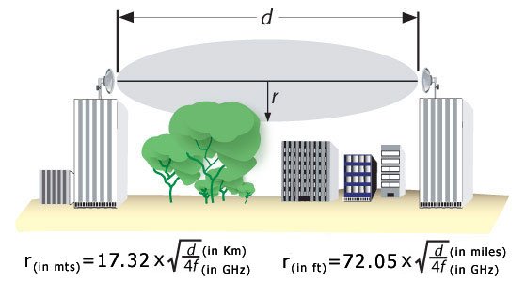
Fresnel Zone
The bigger the Fresnel Zone, the more power
is transmitted

Slide 29
Example: System Effective Gain
Effective Gain:
– 0.5 – 0.5 – 2 – 1 – 0.5 + 8.15 = + 3.65 dB
+ 8.15 dBi
Omni antenna
N-Female to N-Male
Lightning Arrestor
900 MHz is 30 dB
2.4 GHz is 18 dB
40 ft. LMR400
~
~
- 1 dB
- 2 dB total
- 0.5 dB
N-type Female
3 dB = double power
6 dB = double distance
N-type Male
N-type Female
N-type Female
N-type Male
- 0.5 dB
N-type Male
900 MHz Limit is 36 max dB
2.4 GHz Limit is 20 max dB
10 ft. LMR400
- 0.5 dB
123
Reverse Polarity SMA connections
LMR400 coax = 3.9 dB / 100 feet
  0.5 dB loss per connection
  1.0 dB loss for Lightning Arrestor
Gateway
http://info.bannerengineering.com/cs/groups/public/documents/literature/132113.pdf

Slide 30
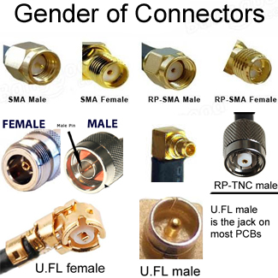
Identifying RF Connectors

Slide 31
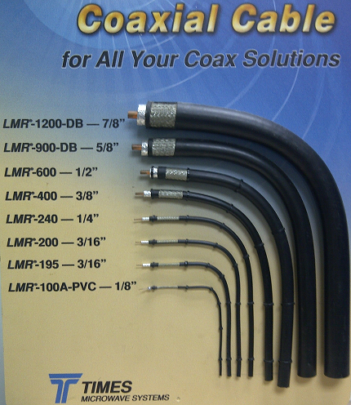
Antenna Cables – LMR Series
This chart depicting different types of Times Microwave LMR Series coaxial cable
Banner has standardized
  RG58, LMR-100 and LMR-200 with RP-SMA connectors
  LMR-400 Low Loss cable with N-Type connector
For example:
  LMR-400 is recommended when longer cable distances are required

Slide 32
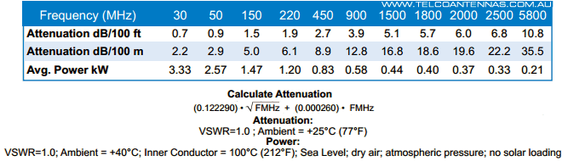
Antenna Cables
Each cable has a signal attenuation related to the frequency used and the length
For example:
  LMR-400

Slide 33
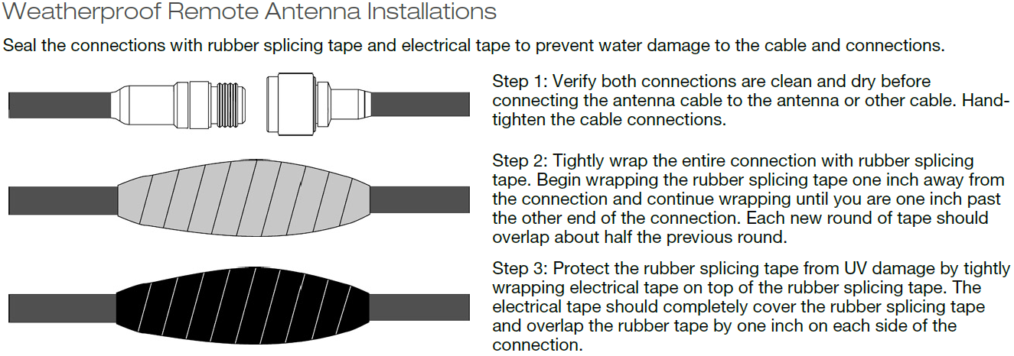
Antenna Cables – Weather Installation

Slide 34
Banner Features

Slide 35
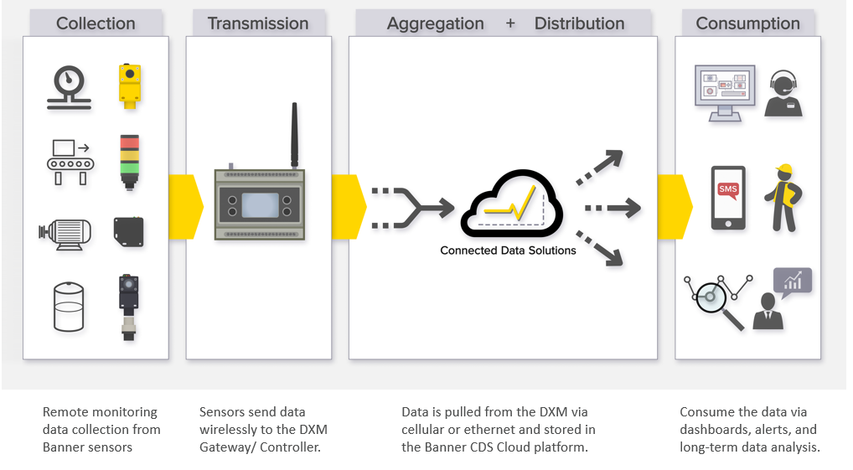
Banner Industrial Solutions
Monitoring
Connectivity

Slide 36

Binding
Pairing process between a Banner Gateway (Master Radio) and node (Slave/Repeater)
Ensures that the nodes (Slave radios) will only communicate and exchange data to a single Gateway (Master radio)
  Allows for multiple wireless networks in the same environment
**Much like the pairing process between a Bluetooth headset and a cellphone

Slide 37
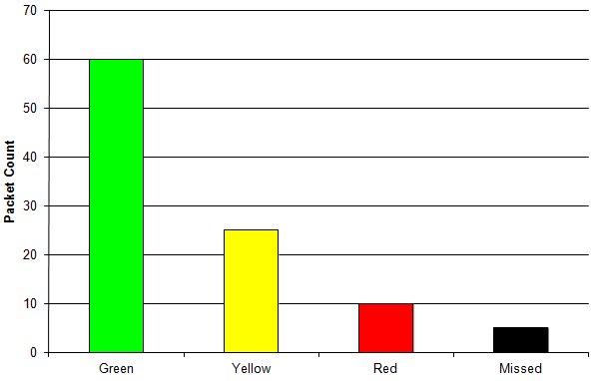
Site Survey
The Gateway will display the site survey results as one of four categories:
  Green = -90 dBm or greater at receiver
  Yellow = Between -90 and -100 dBm
  Red = Less than -100
  Missed = Below Sensitivity - Need to be resent
Site survey should be conducted for all locations where nodes will be installed at – prior to installation
dB is a unit of measurement of sound, relative to two power levels (relative ratio not absolute)
dBm is a measure of power in decibels with reference to one milliwatt
Notes:
Conducting a site survey with your customer is a powerful tool to demonstrate how strong the wireless signal is with Banner Wireless products. It gives them confidence that our products will work well in their facility. If the customer is considering a competitive product, it will give the customer an opportunity to see how much stronger the signal is with Banner Wireless products compared to the competitor.
Sound analogy, whisper, yell, etc.

Slide 38
Applications

Slide 39
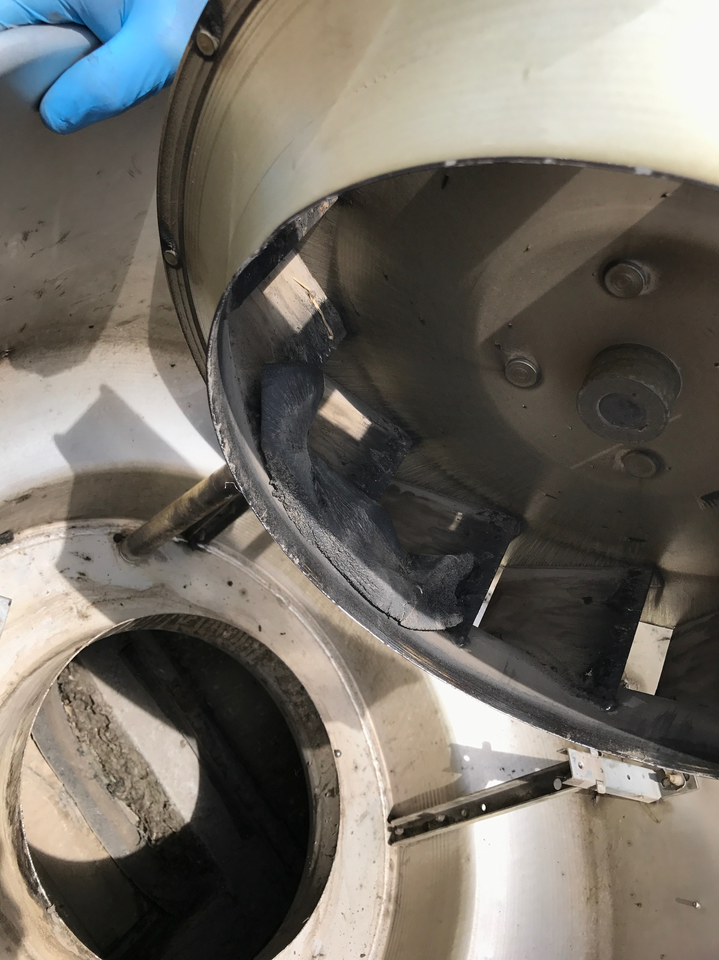
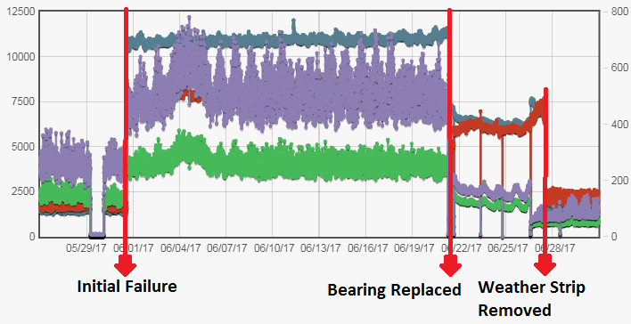
Exhaust Fan
Situation:
Exhaust fans can be crucial to keeping a work area safe for employees and a failure could lead to process downtime. More importantly it can lead to toxic fumes entering the workspace and affecting employee safety. Due to the fan’s location on the rooftop, it was unlikely such failures would be detected in advance
Solution:
Utilizing the Banner Wireless QM42VT1 vibration and temperature
sensor connected to a DX80 Node, an early failure event on a solder wave oven exhaust fan can be detected. In one such instance, initial inspection, it appeared to show a bearing failure. However, after bearing replacement, the RMS Velocity remained at 3-4 times baseline values even though RMS Acceleration had come down to near baseline levels. Upon further inspection, a 7” piece of weather seal had adhered to a fan blade and was
causing an imbalance condition.
Value:
Cost Avoidance – Prevents down-time of the machine and avoids catastrophic failure
Safety – Prevented toxic fumes from accumulating in work area
IIOT - Ability to remotely monitor assets without human intervention or in hard to access areas

Slide 40
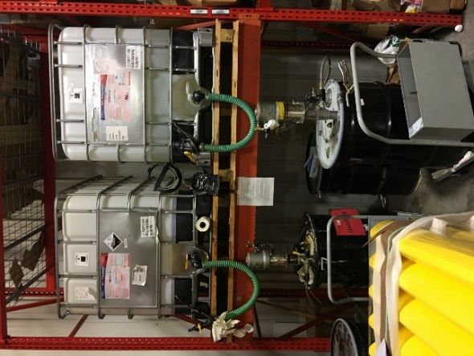
Tank Level Monitoring
Situation:
55 gal barrels were gravity filled from totes. Due to the viscosity of the fluid it took hours to fill and thus workers could get distracted. This caused an overfill situation that took two workers, a full day to clean-up. It required them to use respirators due to the chemicals and more than $500 in materials.
Value:
  Easy way to migrate to IIOT remote monitoring
  Helps prevent tank overfills and provides level status
  Lower cost/complexity in plant reconfigurations
  Ability to monitor supply tanks in remote locations without human intervention
  Avoidance of one incidence pays for the system
  Improved worker safety
Applications:
  Supply tote/55 gal supply tank level monitoring
  Remote fuel tank level (prevents incidences of pump cavitation)
  Process monitoring - vat or storage vessel level monitoring

Slide 41
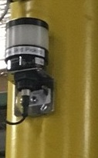
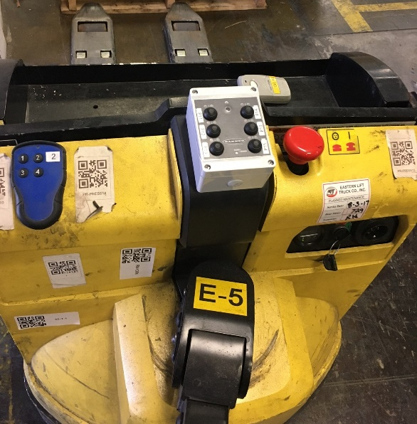
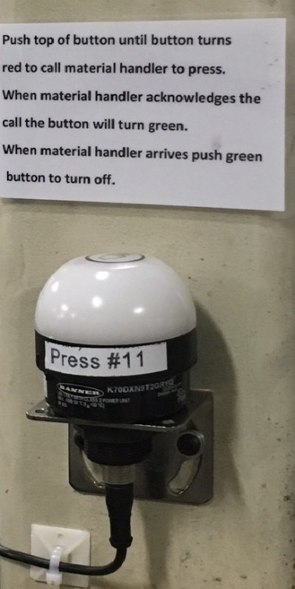
Call for Assistance
Situation:
When a completed roll of material was completed the operator would need to get a fork operator to pick up the material. Tracking down the fork truck was inefficient causing lost time and efficiency.
Six Lines
Solution:
Utilizing the Banner wireless a system was created. The system involved having a wireless touch button at each line. When material pickup was required the line operator would press the button. It would like up red stating that signal has been sent to fork operator. A six-button box is located on the fork. A red light will flash on the box when a request by a line has been made. Each line has a specific button on the box. After request is acknowledged the lights at box locations will turn green. After material is picked up line operator presses the local button again and both lights turn off. Lastly there is a centeralized light that turns on when any light requires assistance.
Value:
Timer – Material arrives to line 15 to 20 minutes faster then before.
OEE – Improved OEE metrics for lines
Relationships – Relationships between line and fork operators improved.

Slide 42
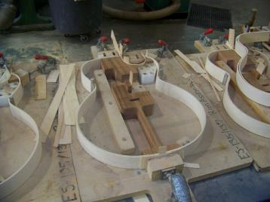

Temp/Humidity Monitoring
Humidity Control at Musical Instrument Manufacturer
Relative Humidity needs to stay between 45% - 50%
Control was previously done manually
Banner Temp & Rh sensor / DXM100 connects to control panel to automatically set off misters below 45% and controls temperature when the Rh is above 50%

Slide 43
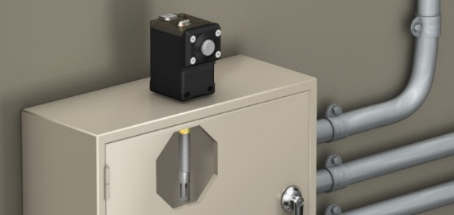
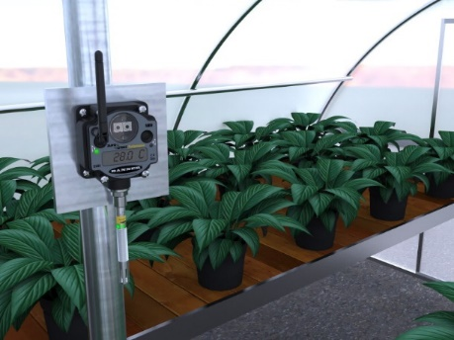
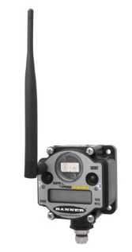


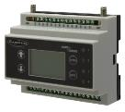

Temp and Humidity Monitoring
Monitor temperature and humidity levels
Use temperature data to track and control area temperatures to avoid wasted energy
Set warning and alarm levels
  Use tower lights for warning indication, text and/or email alerts, log the data
Monitor humidity levels in control cabinets to avoid corrosion and early failure
Products:
M12FTH4Q / 3Q
Q45VT or Q45U
DXM100
P6 or P6L

